Slide 1

API Design Methodology
Mike Amundsen API Academy / CA @mamund

Slide 2

APIs for the Web

Slide 3
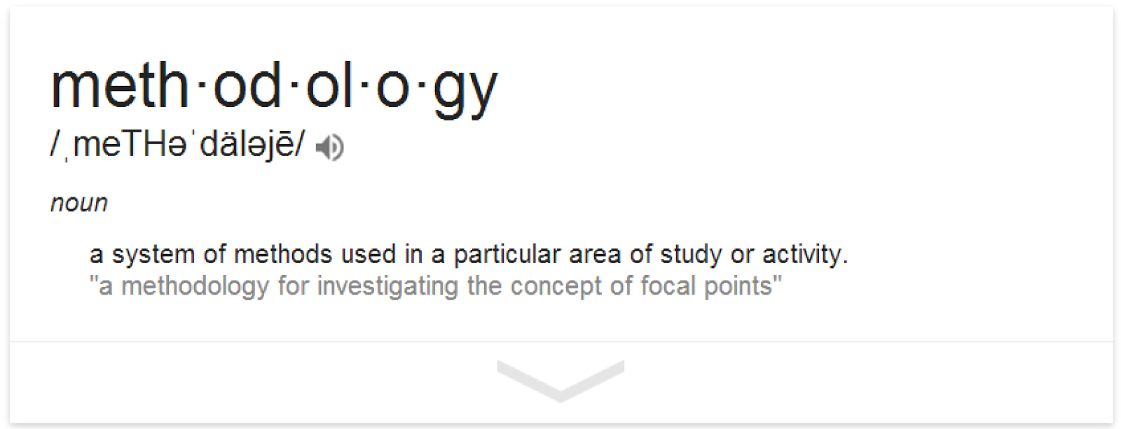

Slide 4
Actually, we have a methodology already...

Slide 5
Design Guidelines
Craft [good/pretty/usable/stable] URIs

Slide 6
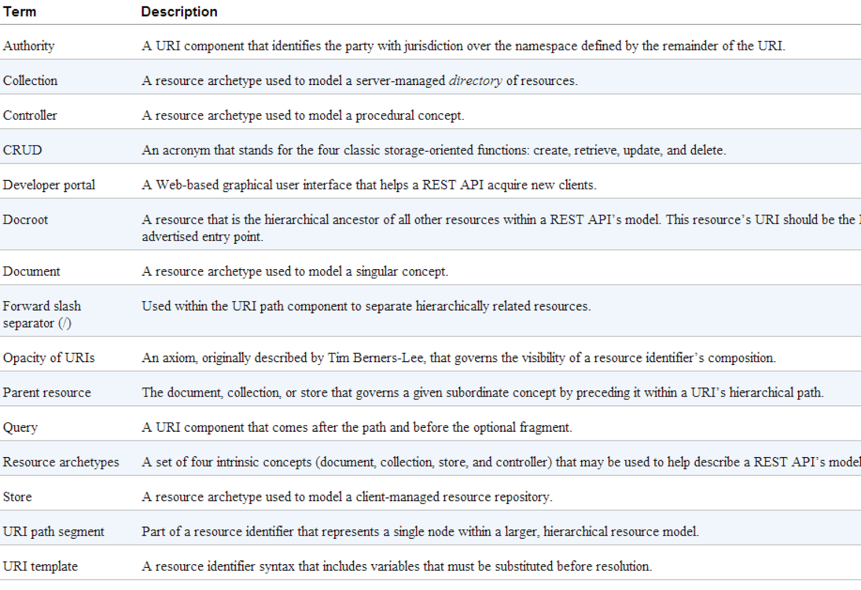

Slide 7
Design Guidelines
Craft [good/pretty/usable/stable] URIs
Map domain actions to HTTP methods (CRUD)

Slide 8
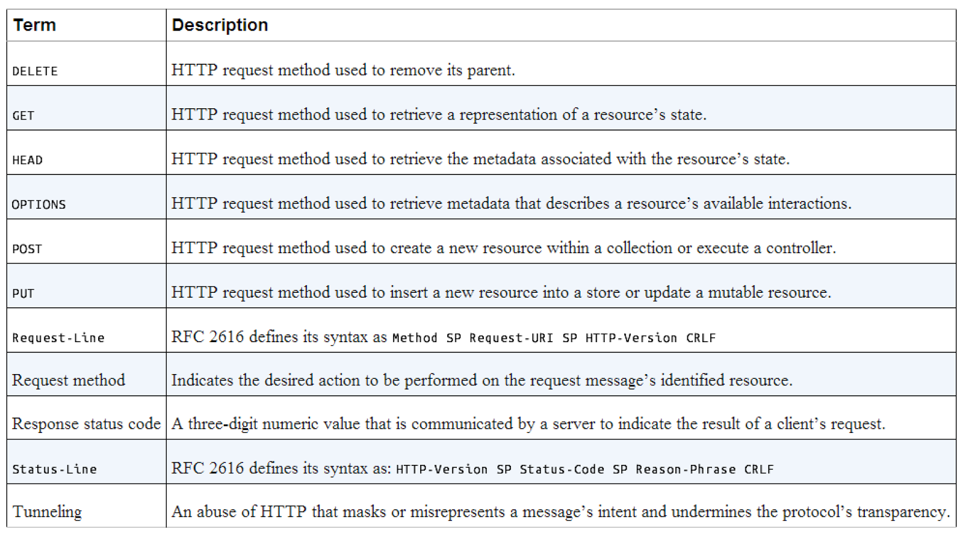

Slide 9
Design Guidelines
Craft [good/pretty/usable/stable] URIs
Map domain actions to HTTP methods (CRUD)
Use the proper HTTP Status Codes

Slide 10
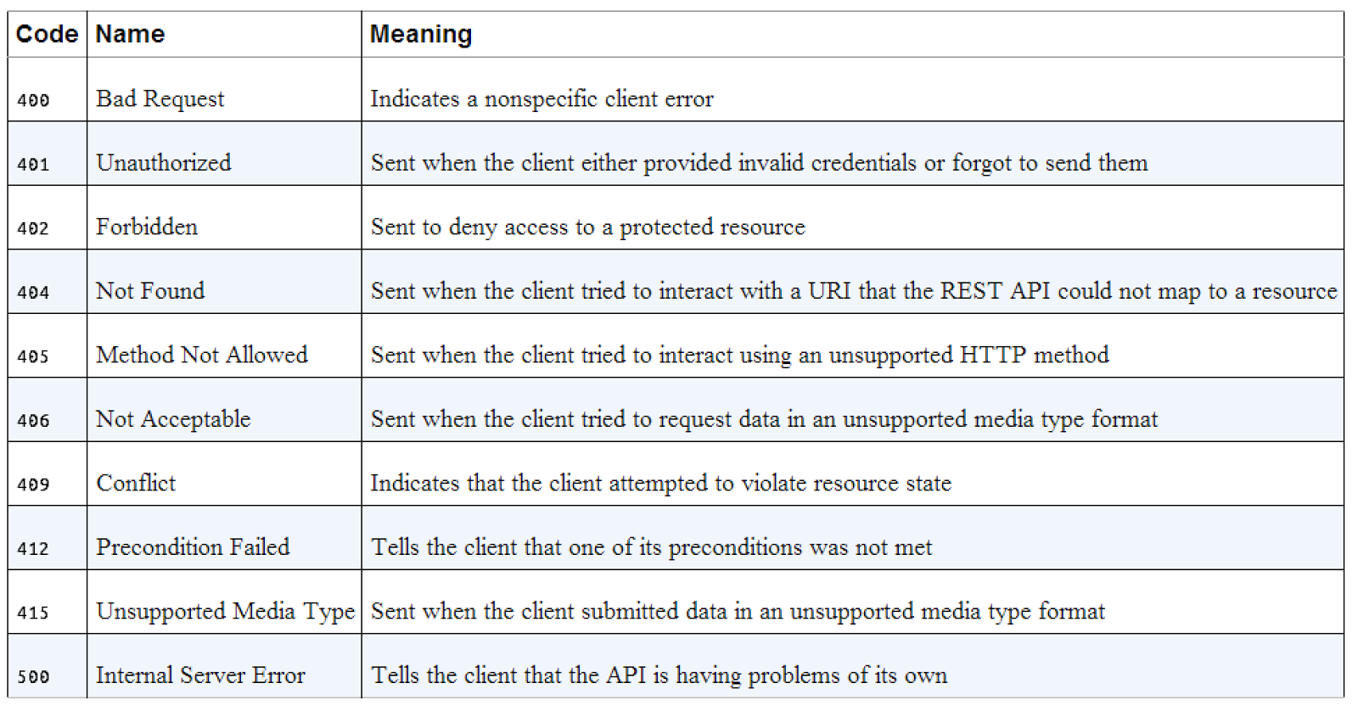

Slide 11
Design Guidelines
Craft [good/pretty/usable/stable] URIs
Map domain actions to HTTP methods (CRUD)
Use the proper HTTP Status Codes
Document serialized objects as HTTP bodies

Slide 12
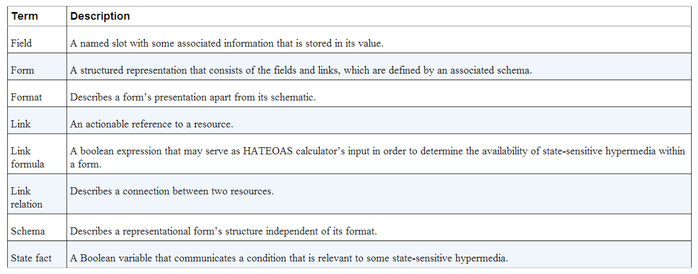

Slide 13
Design Guidelines
Craft [good/pretty/usable/stable] URIs
Map domain actions to HTTP methods (CRUD)
Use the proper HTTP Status Codes
Document serialized objects as HTTP bodies
Use HTTP headers responsibly

Slide 14
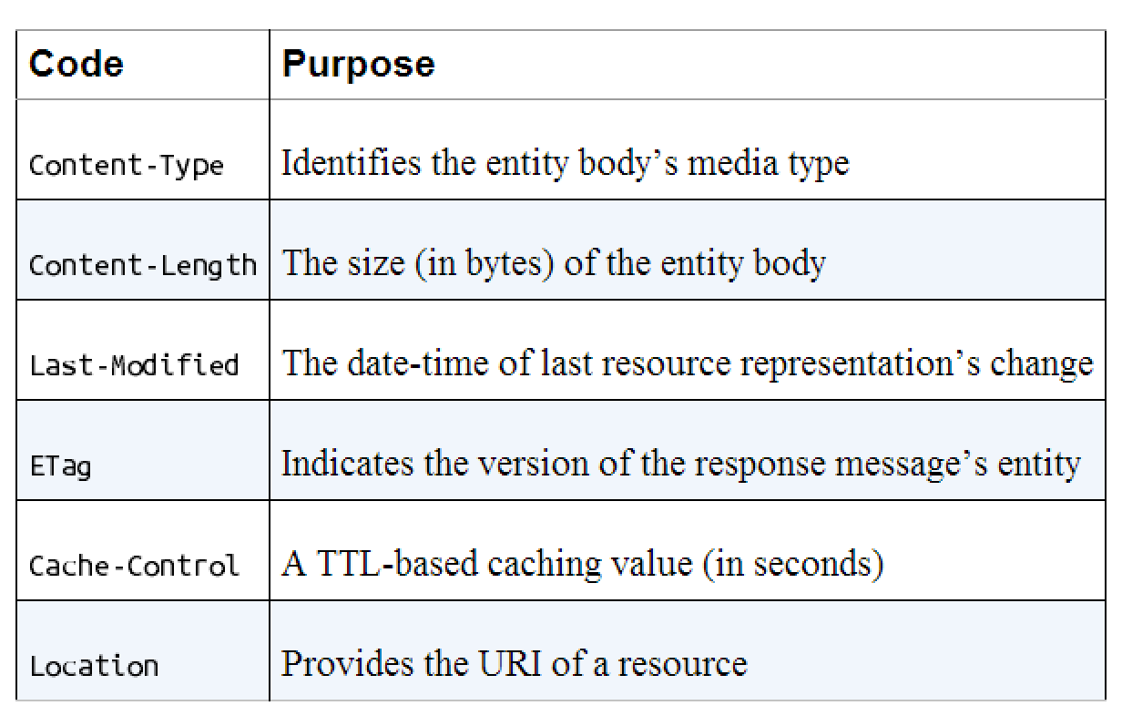

Slide 15
Design Guidelines
Craft [good/pretty/usable/stable] URIs
Map domain actions to HTTP methods (CRUD)
Use the proper HTTP Status Codes
Document serialized objects as HTTP bodies
Use HTTP headers responsibly
Describe edge cases (async, errors, authN/Z)

Slide 16
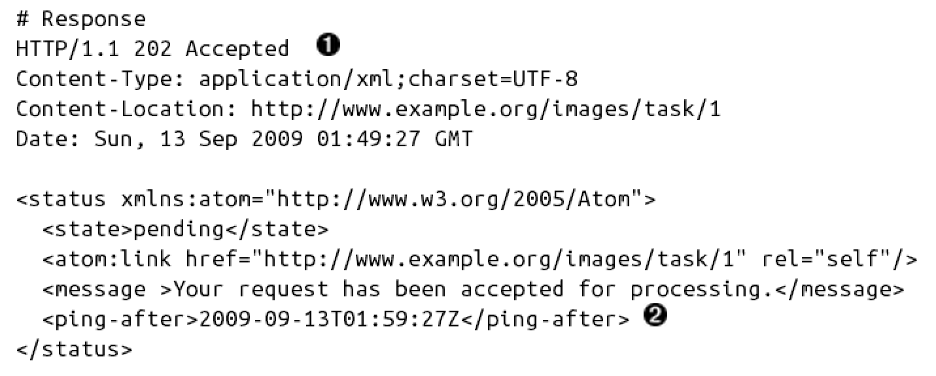

Slide 17
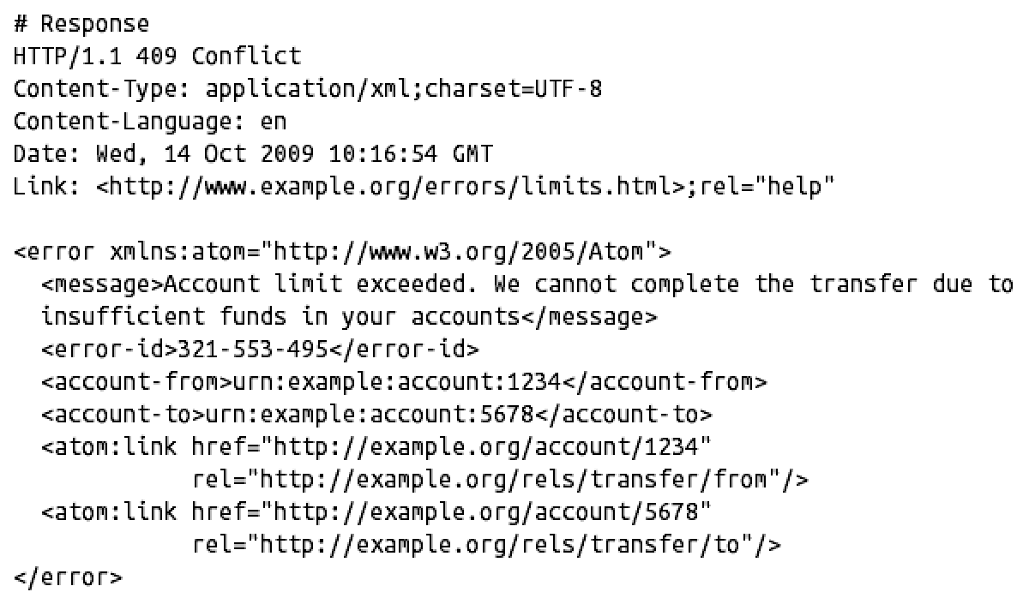

Slide 18
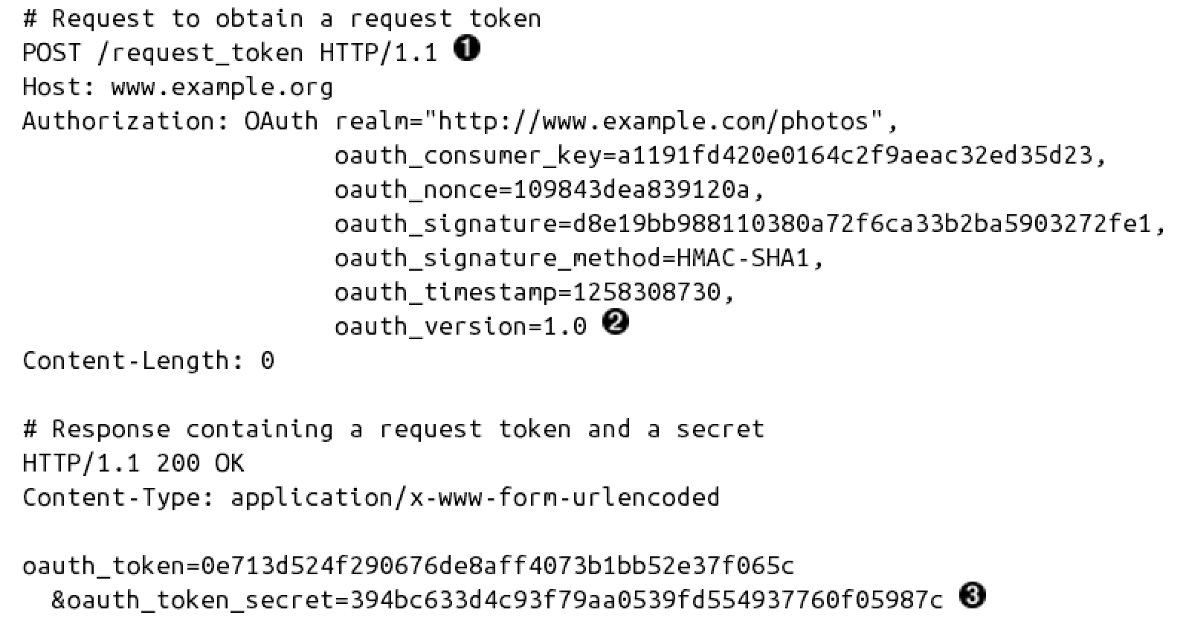

Slide 19
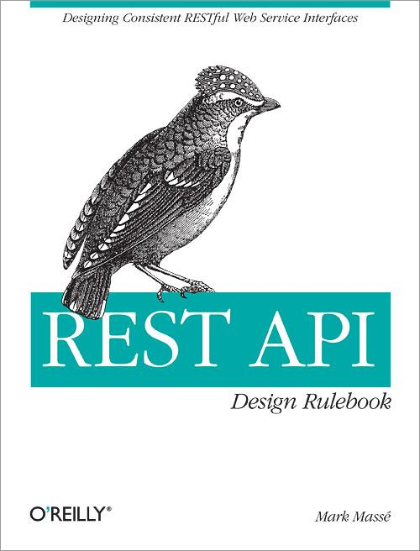

Slide 20
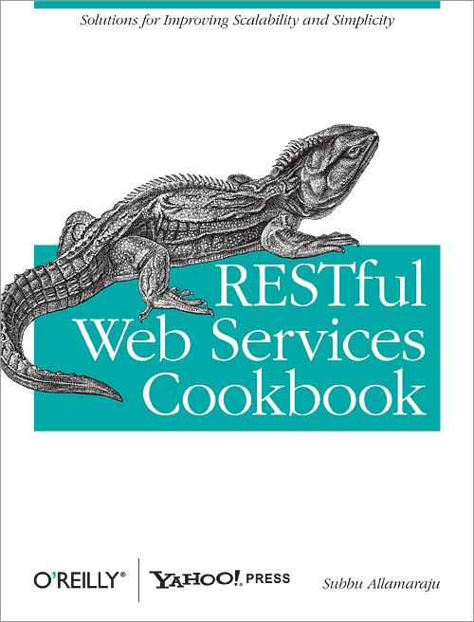

Slide 21
But there's a problem here...

Slide 22
Those are not design guidelines..

Slide 23
They are implementation guidelines!

Slide 24
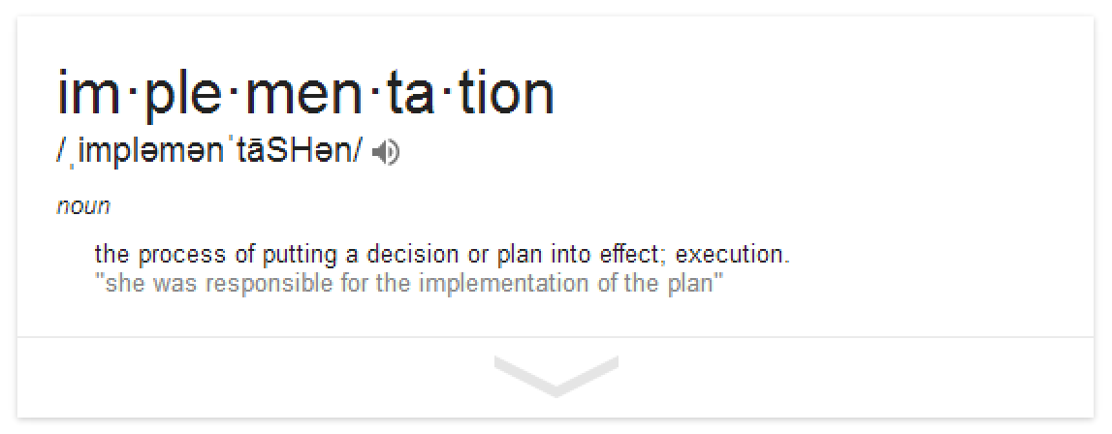

Slide 25
Ok, so what is a design methodology, then?

Slide 26
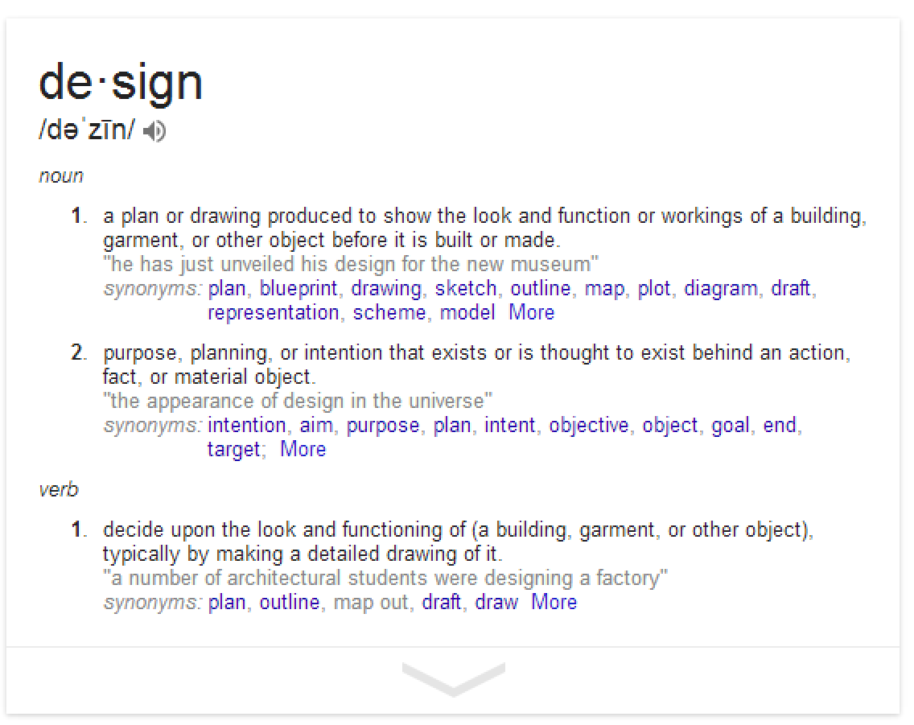

Slide 27
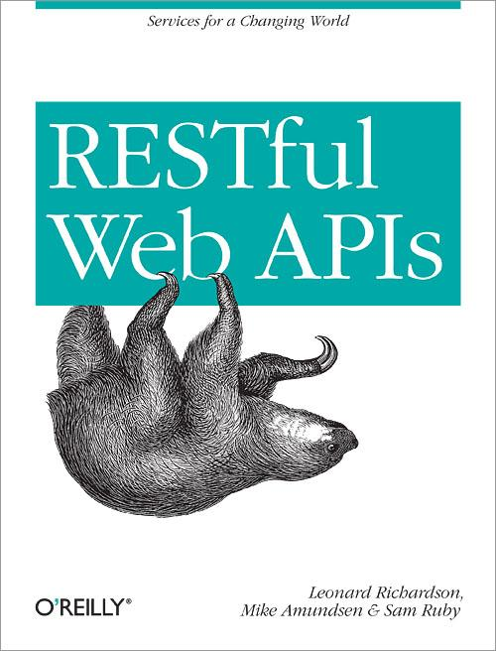

Slide 28
Here's a simple seven-step procedure...

Slide 29
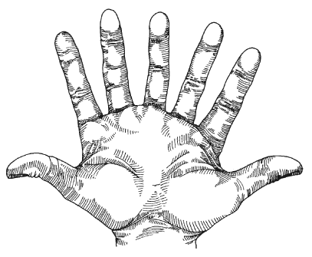
Yep, seven steps.

Slide 30
1. List the Semantic Descriptors

Slide 31
1. List the Semantic Descriptors (the what?)

Slide 32


Ubiquitous Language
Ubiquitous Language is the term Eric Evans uses in Domain Driven Design for the practice of building up a common, rigorous language between developers and users. This language should be based on the Domain Model used in the software - hence the need for it to be rigorous, since software doesn't cope well with ambiguity. -- Martin Fowler, 2006

Slide 33
1. List the Semantic Descriptors
id (unique string)
title (string)
completed (true/false)
CRUD (create, read, update, delete)
listAll tasks
listActive (completed=false)
listCompleted (completed=true)
findByName (partial match)

Slide 34
2. Draw a State Diagram

Slide 35

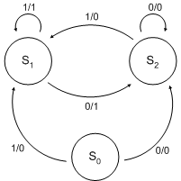
State Charts
State Charts are compact and expressive – small diagrams can express complex behavior – as well as compositional and modular. -- David Harel, 2002

Slide 36
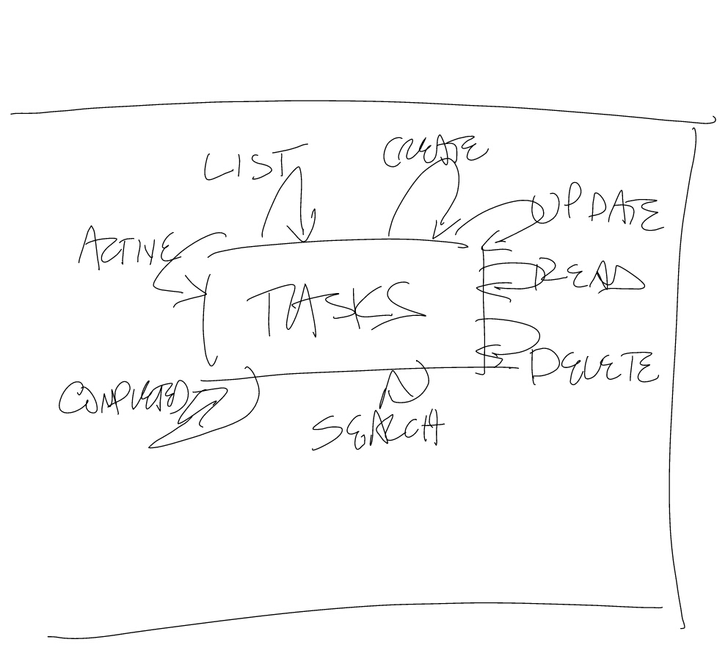

Slide 37
3. Reconcile Names

Slide 38
3. Reconcile Names
IANA Link Relation Values
schema.org
microformats
Dublin Core
Activity Streams

Slide 39
3. Reconcile Names
id
title
completed
Create, read, update, delete
listAll
listActive
listCompleted
findByName

Slide 40
3. Reconcile Names
id (data)
title (data)
completed (data)
Create, read, update, delete
listAll – IANA collection
listActive – IANA collection
listCompleted IANA collection
findByName – search

Slide 41
OK, that was the design part...

Slide 42
But I still need to implement it, right?

Slide 43
4. Choose a Media Type

Slide 44
4. Choose a Media Type
Use application/json, application/xml
Collection type: Atom, OData, Collection+JSON
Free-form: HTML, Siren, HAL, JSON-LD
Invent your own semantic type

Slide 45


Message-Passing
The big idea is "messaging" - that is what the kernel of Smalltalk/Squeak is all about The key in making great and grow-able systems is much more to design how its modules communicate rather than what their internal properties and behaviors should be.
-- Alan Kay, 1998

Slide 46
4. Choose a Media Type
Use application/json, application/xml
Collection type: Atom, OData, Collection+JSON
Free-form: HTML, Siren, HAL, JSON-LD
Invent your own semantic type

Slide 47
4. Choose a Media Type
Use application/json, application/xml
Collection type: Atom, OData, Collection+JSON
Free-form: HTML, Siren, HAL, JSON-LD
Invent your own semantic type

Slide 48
4. Choose a Media Type
Use application/json, application/xml
Collection type: Atom, OData, Collection+JSON
Free-form: HTML, Siren, HAL, JSON-LD
Invent your own semantic type

Slide 49
4. Choose a Media Type
Use application/json, application/xml
Collection type: Atom, OData, Collection+JSON
Free-form: HTML, Siren, HAL, JSON-LD
Invent your own semantic type

Slide 50
4. Choose a Media Type
Use application/json, application/xml
Collection type: Atom, OData, Collection+JSON
Free-form: HTML, Siren, HAL, JSON-LD
Invent your own semantic type

Slide 51
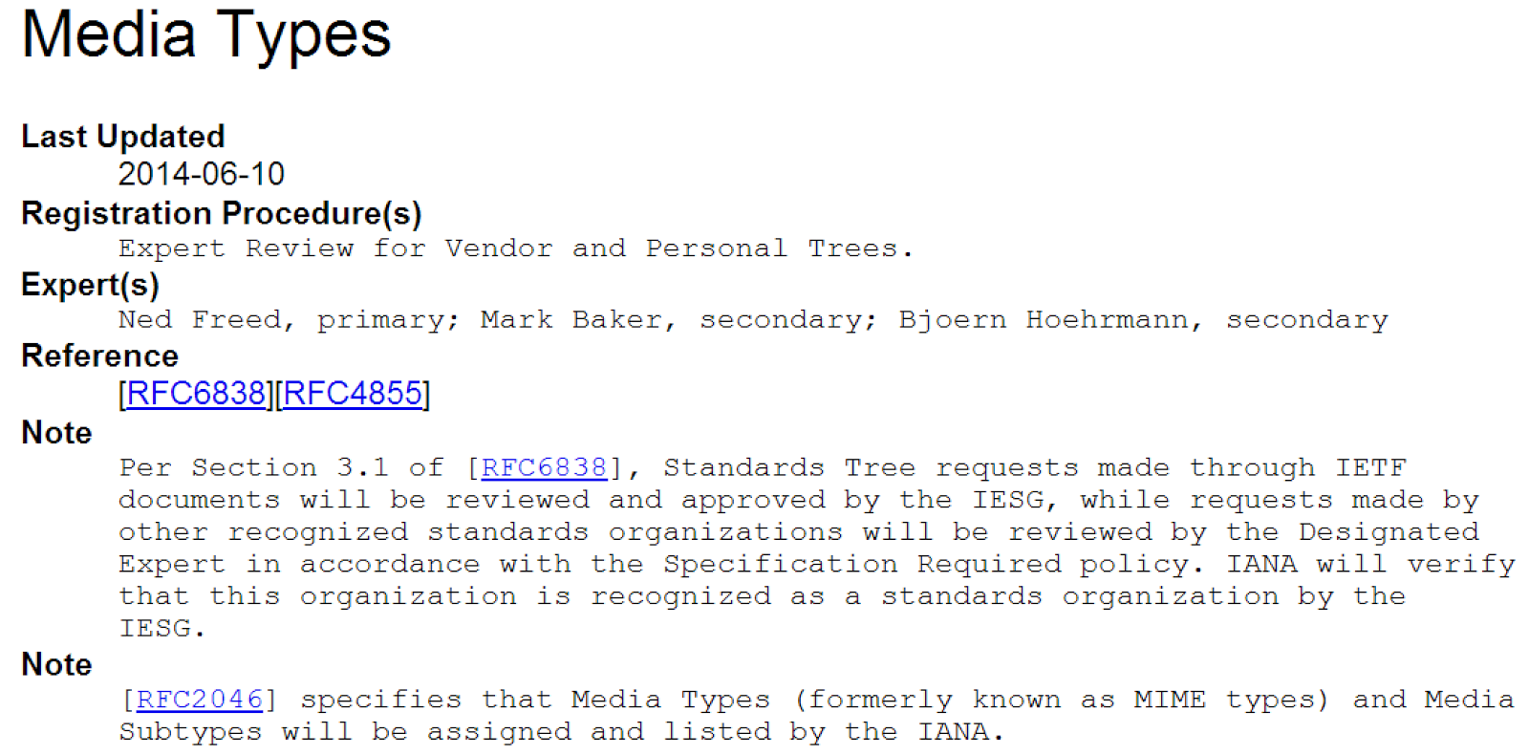

Slide 52
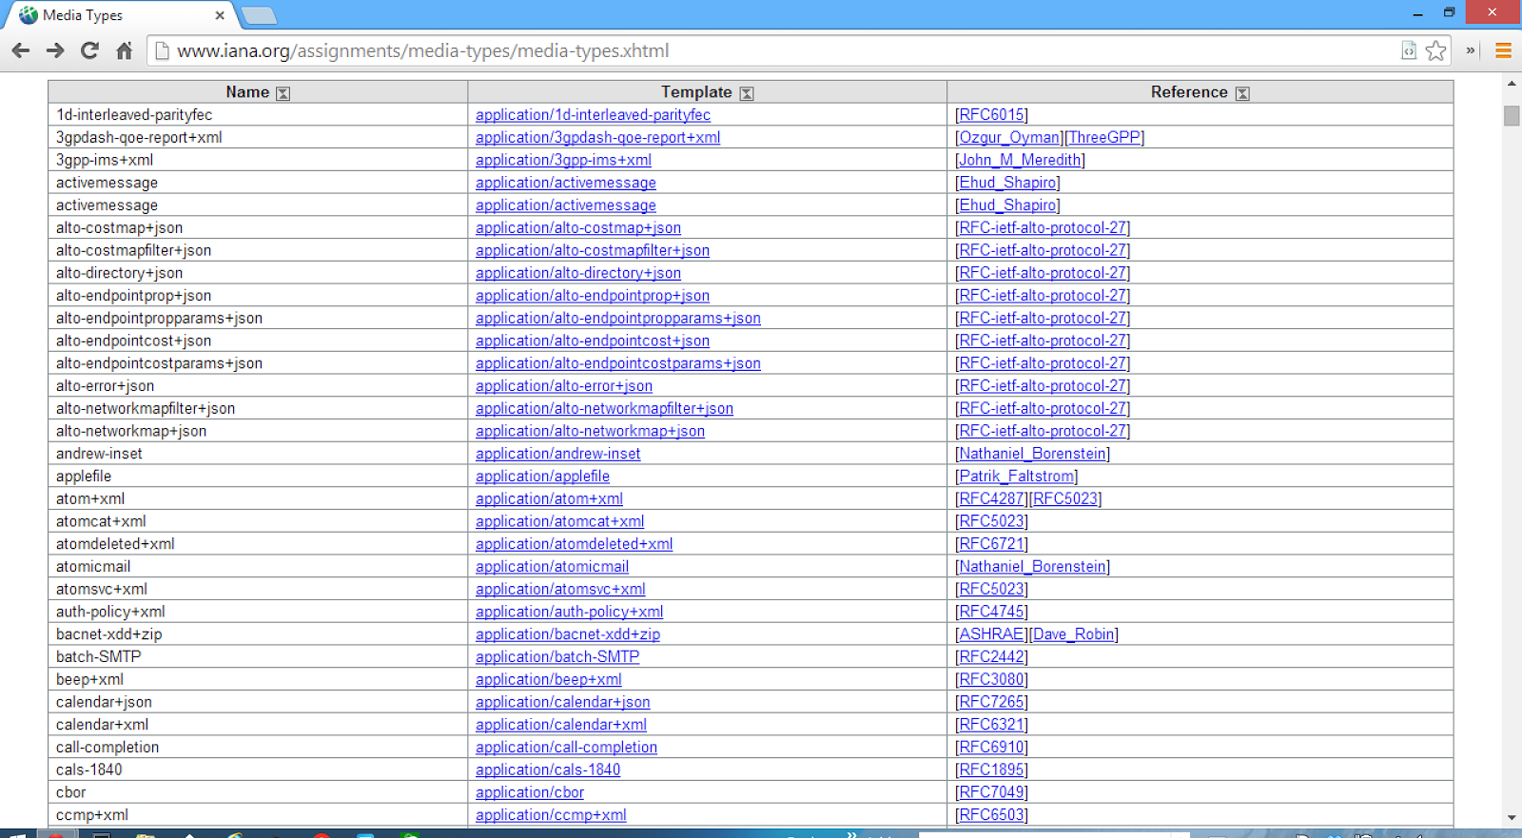

Slide 53
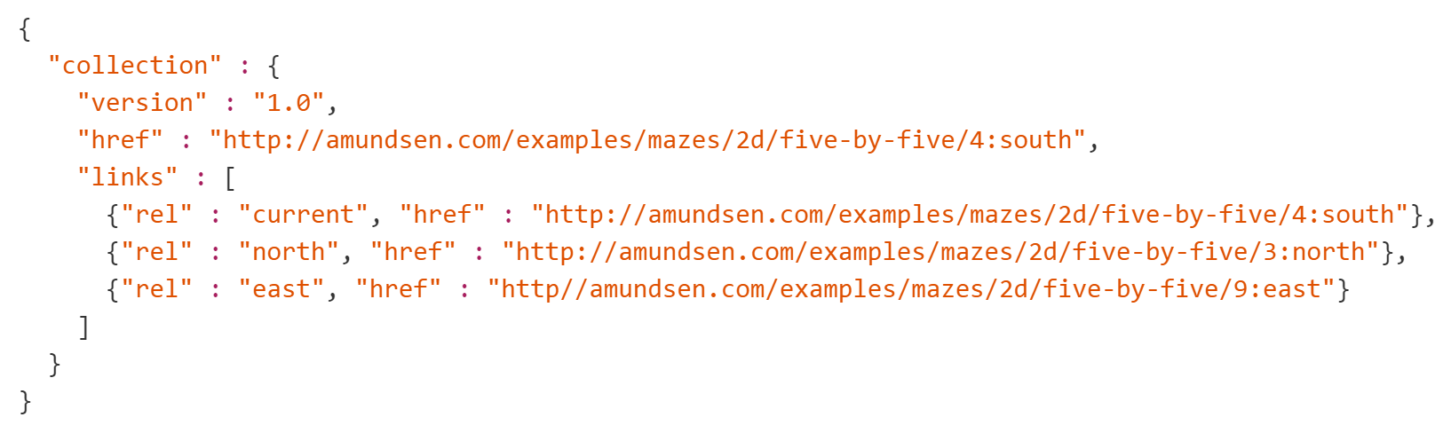
Collection+JSON

Slide 54
5. Write a Profile

Slide 55


Profiles RFC
A profile allows clients to learn about additional semantics that are associated with the resource. -- Erik Wilde, 2013

Slide 56
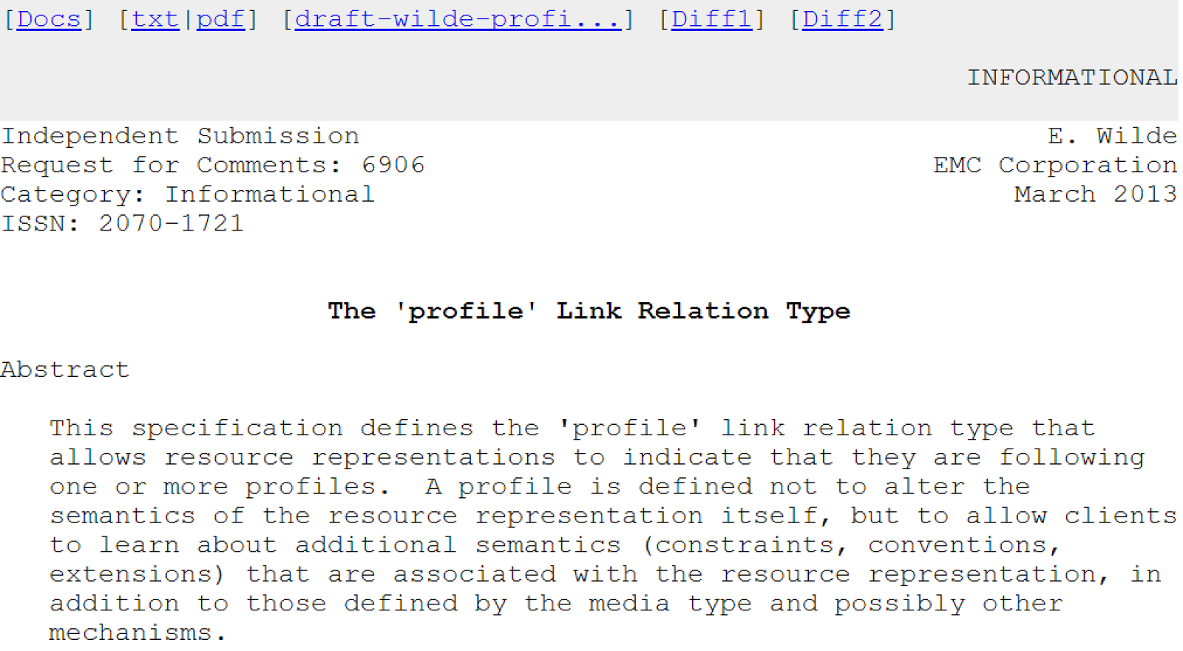

Slide 57
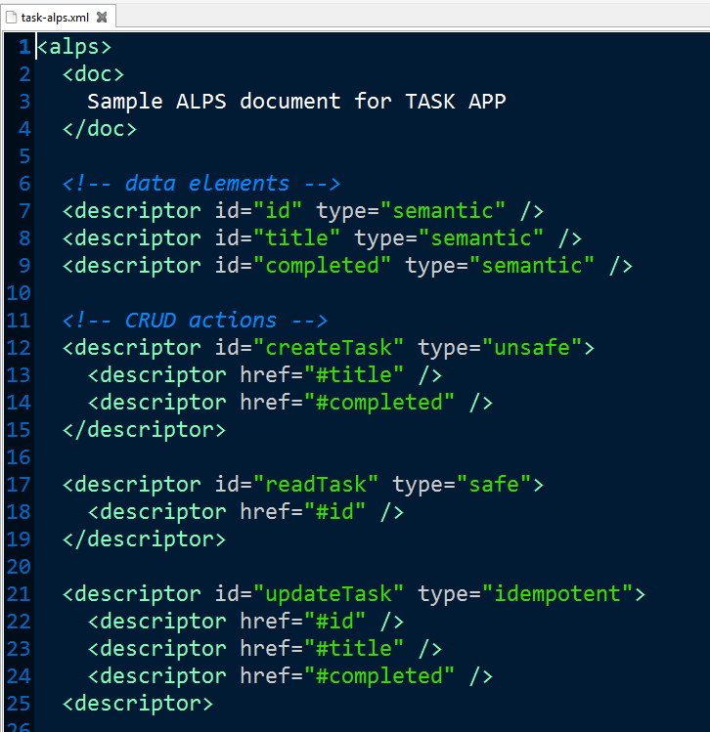

Slide 58
6. Implementation

Slide 59
6. Implementation ta-da!

Slide 60
And now we have running code!

Slide 61
Wait, what's step seven?

Slide 62
7. Publication

Slide 63
7. Publication
Publish your "billboard" URL
Publish your profile
Register new rel values and/or media types
Publish the documentation
Consider "well-known" URIs

Slide 64
Now, you're done!

Slide 65
Seven Simple Steps
List the Semantic Descriptors
Draw a State Diagram
Reconcile Names
Write a Profile
Select a Media Type
Implementation
Publication

Slide 66
API Design Methodology

